Slide 1
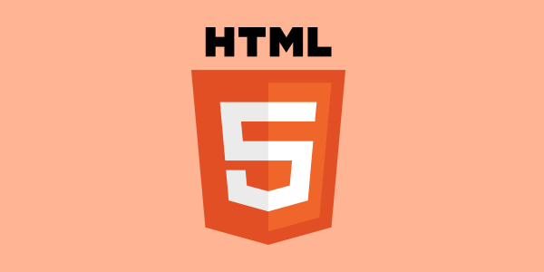

Slide 2
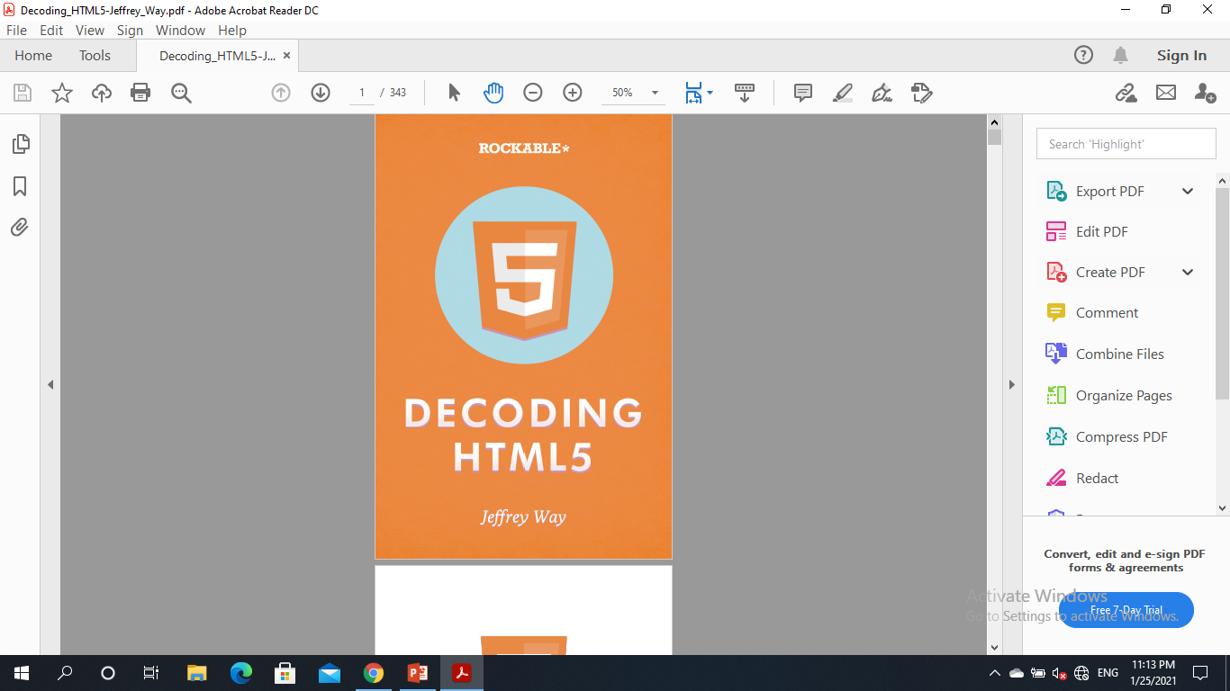
The book we are referring to in this summary.
ROCKABLE
Rockablepress.com
Envato.com
© Rockable Press 2012
All rights reserved. No part of this publication may be reproduced or redistributed in any form without the prior written permission of the publishers.

Slide 3

We are living in the future of the past IT’S THE PRESENT that will be the past of the future So Obviously we are living on actions and events that happened in the past (THE HISTORY) with improving and developing them to be suitable for now

Slide 4
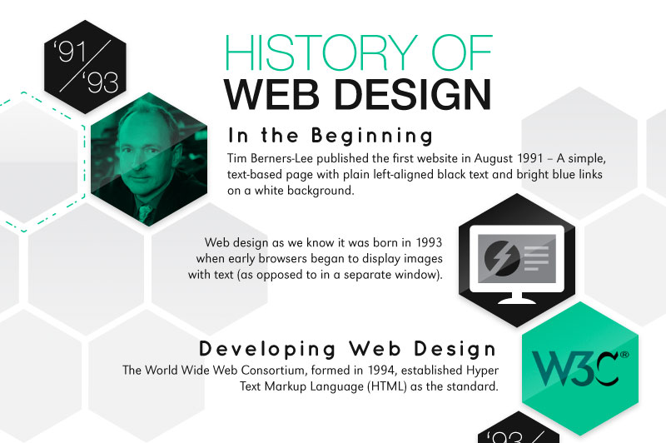

Lets Begin with Web Working Groups

Slide 5

What’s the Difference Between the W3C, WHATWG, and HTMLWG?
• W3C – A community with the sole purpose of working to develop web standards.
• WHATWG – Formed after various members of the W3C became agitated by the direction being taken with XHTML 2.0. They preferred a different, less drastic, approach, where the existing HTML was extended.
• HTMLWG – Once the W3C finally recognized that XHTML 2.0 was not the future, they indicated that they wished to work with the WHATWG on development of what would eventually become HTML5. They chartered the HTMLWG for this purpose.

Slide 6
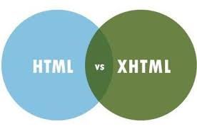



Slide 7
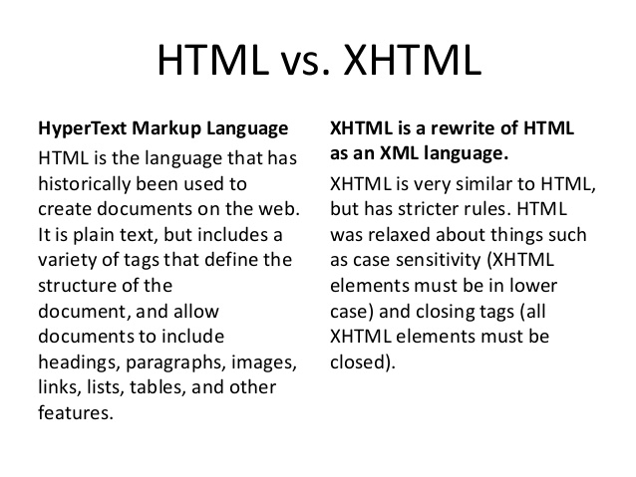
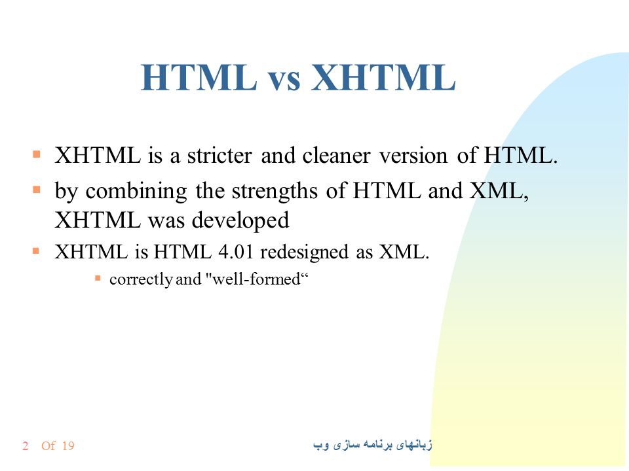
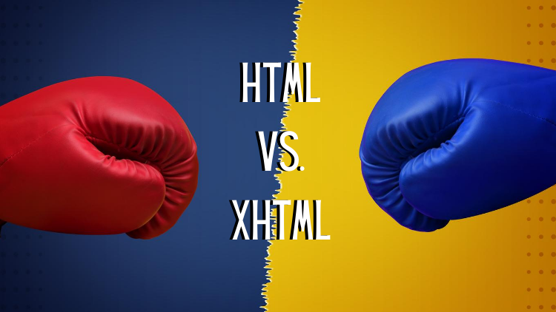

Slide 8
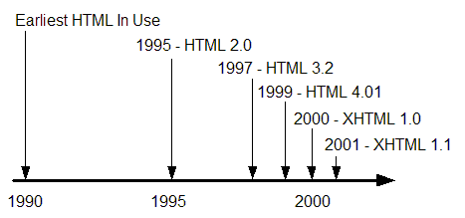
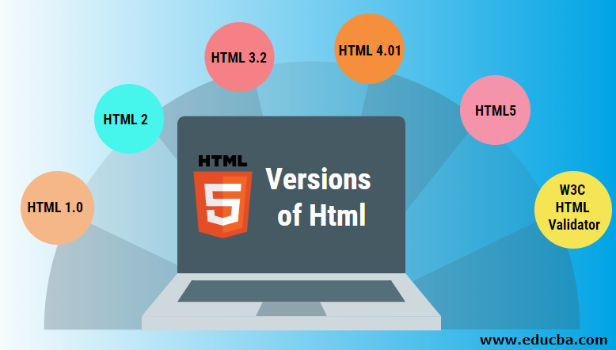

Slide 9




W3C wasted a lot of time on developing XHTML and XHTML2.0 aiming for consensus
WHATWG with Lan Hickson that has his vision for new web approach even with the disagreement of the group

Slide 10



TO

Slide 11
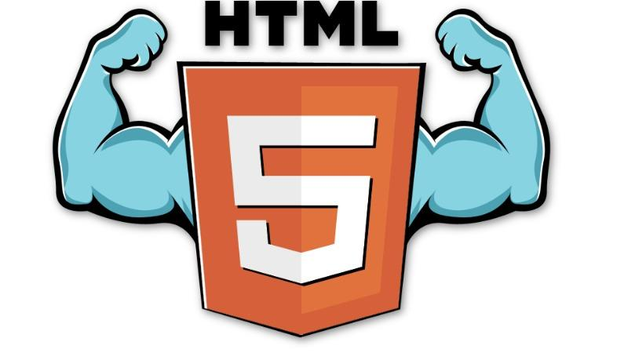

The enmity was between 2 groups which led to slow progress for W3C while WHATWG progress quickly. After a time it was clear for W3C that XHtml2.0 was not the solution. In 2006 W3C collaborated with WHATWG on what would be Html5. The created group from W3C and WHATWG was intended to continue development of Html.

Slide 12
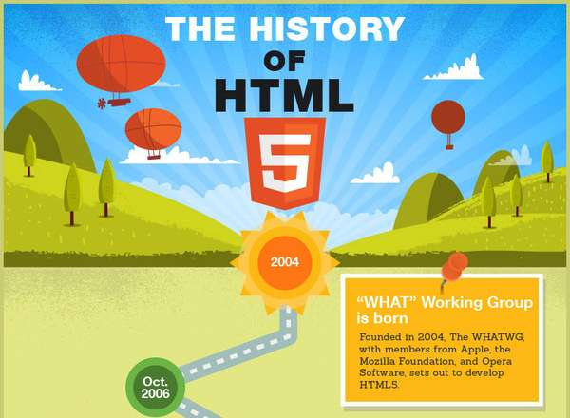
HTML5 is the latest evolution of the standard that defines HTML. The term represents two different concepts. It is a new version of the language HTML, with new elements, attributes, and behaviors, and a larger set of technologies that allows the building of more diverse and powerful Web sites and applications. This set is sometimes called HTML5 & friends and often shortened to just HTML5.
Designed to be usable by all Open Web developers, this reference page links to numerous resources about HTML5 technologies, classified into several groups based on their function.

Slide 13
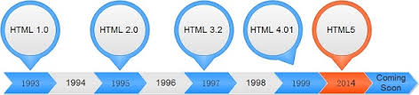


Html5 word is the most popular word in the past few years where literally everyone would say it.

Slide 14




WHO WILL WIN In HTML5 SUPPORT

Slide 15
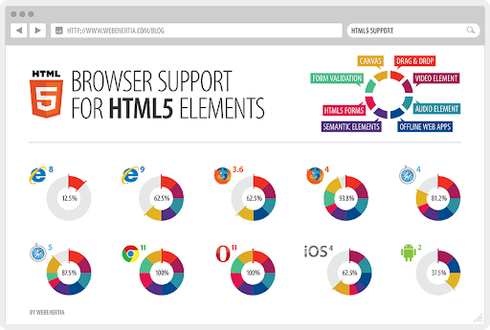

Slide 17

A polyfill is a browser fallback, made in JavaScript, that allows functionality you expect to work in modern browsers to work in older browsers, e.g., to support canvas (an HTML5 feature) in older browsers.
It's sort of an HTML5 technique, since it is used in conjunction with HTML5, but it's not part of HTML5, and you can have polyfills without having HTML5 (for example, to support CSS3 techniques you want).

Slide 18
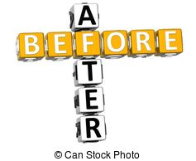

Slide 19

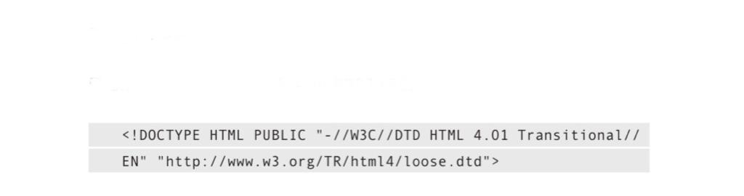

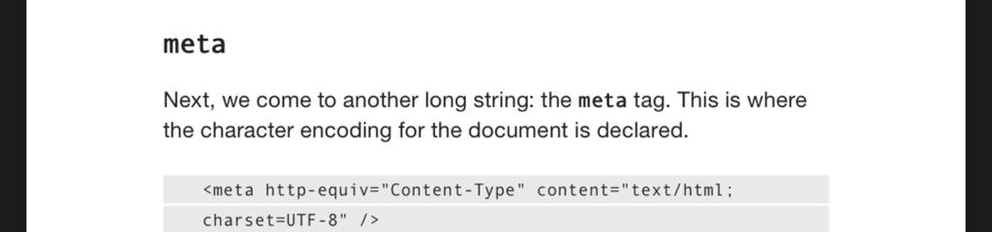
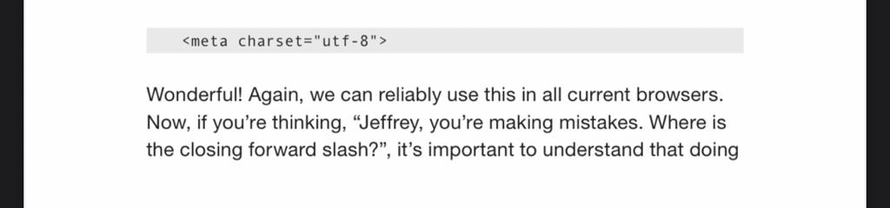
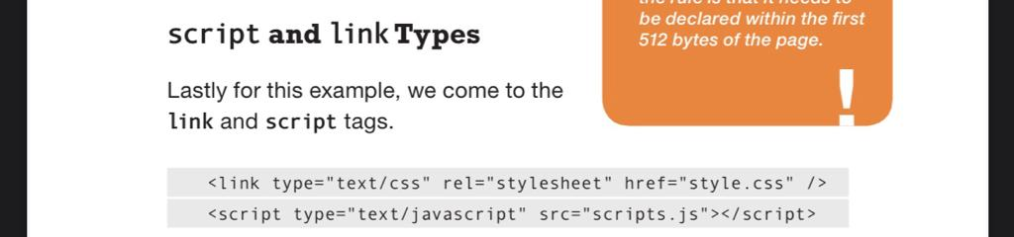
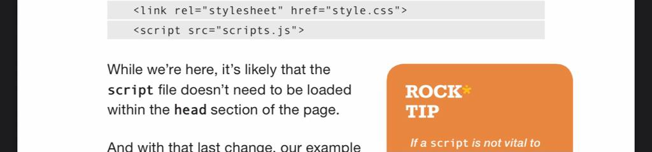
DOCTYPE:
Meta:
Script and Type:

Slide 20


Slide 21
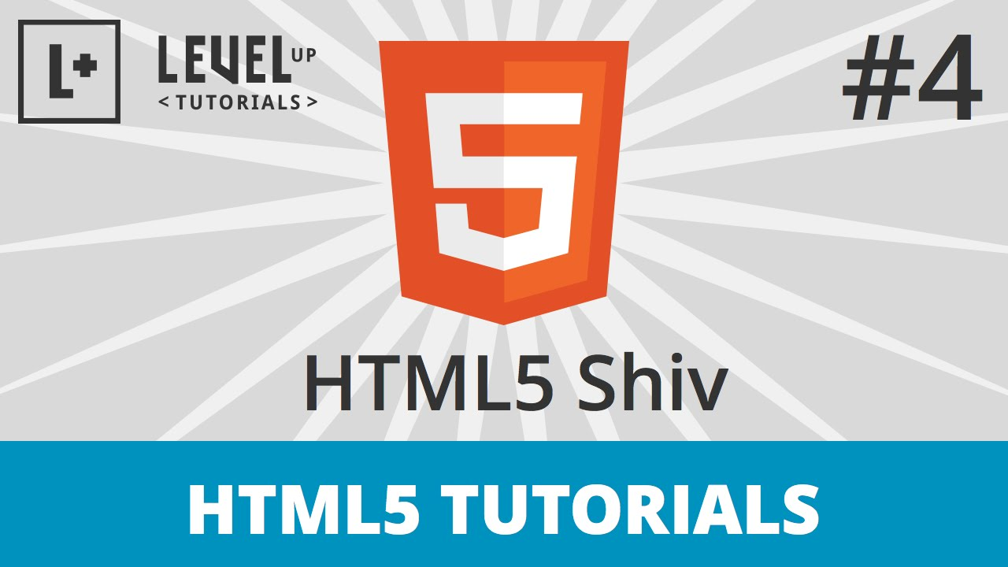
Old versions of browser don’t see the new Html5 new elements and does not display them as expected if they saw them
They need to DOM created using JavaScript.
Here comes Html5 Shiv/Shim that will acknowledge IE with new elements by taking care of the creation of DOM elements and displaying them as expected.

Slide 22
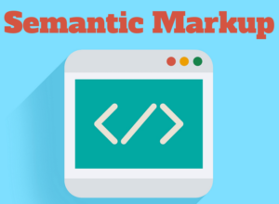

Slide 23
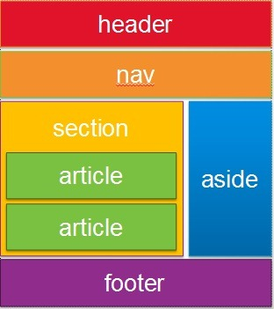
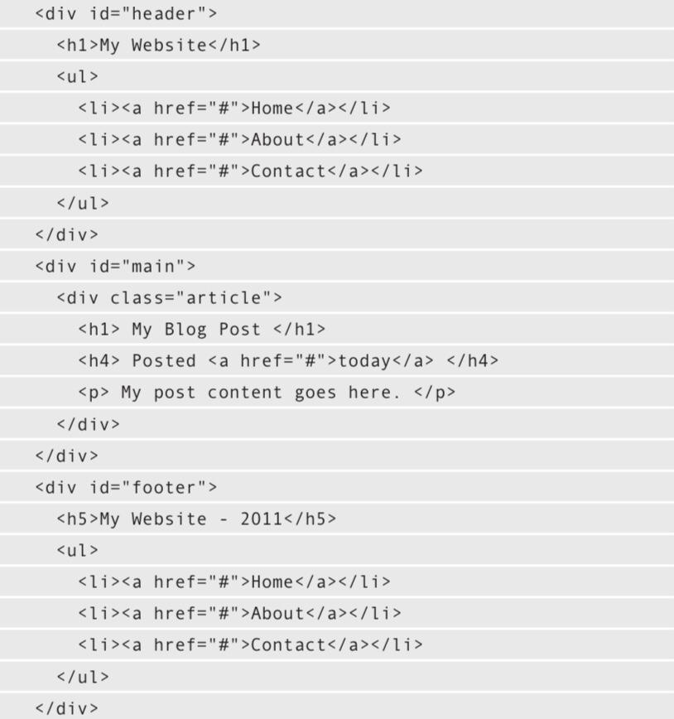
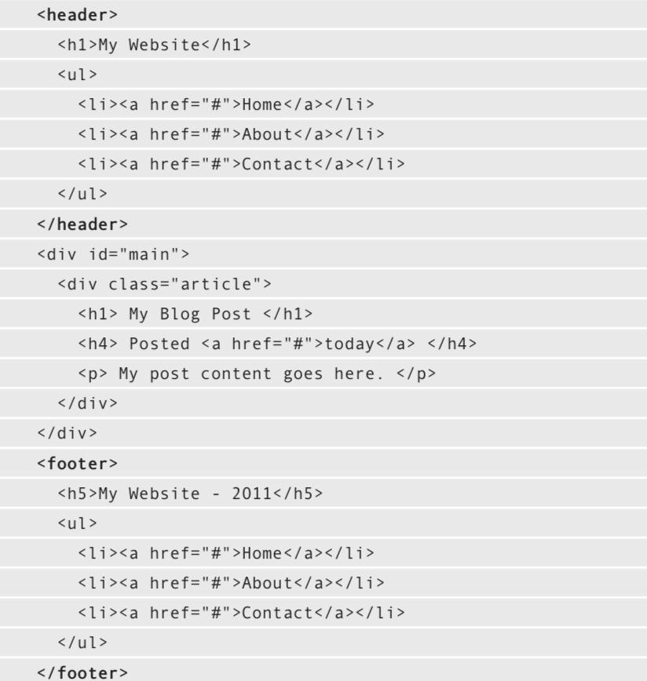
Semantic Markup

Slide 24
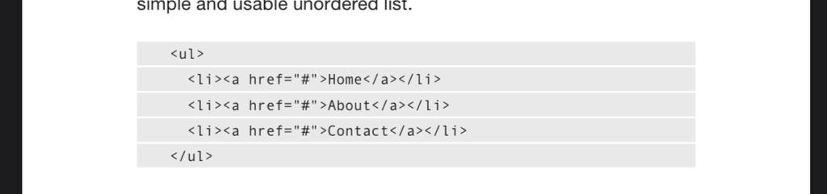
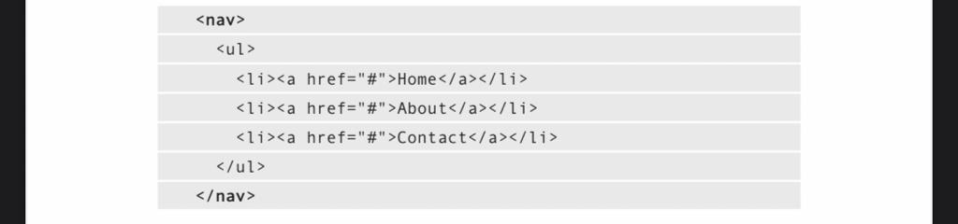
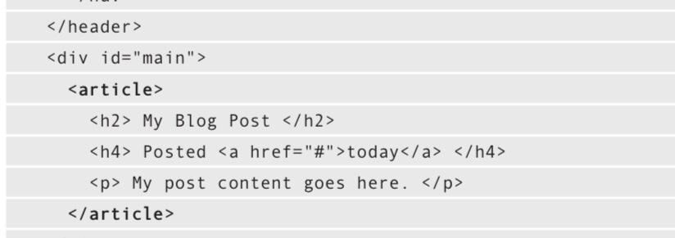
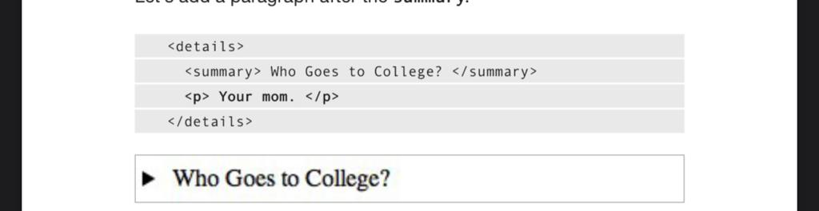
This sectioning of the html page add more meaning to the cold code and describe it in a more meaningful way.

Slide 25
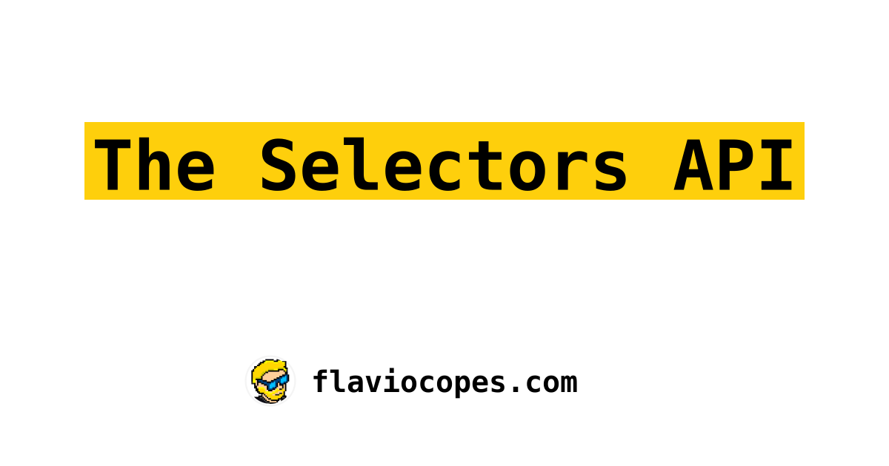

Slide 26
Easy Queries with the Selectors API
querySelector()
Selects the first element that matches the CSS selector passed.
querySelectorAll()
Selects the all elements that matches the CSS selector passed.
Both API functions take as parameter familiar CSS selector and returns Static Node List
Static Node List vs Live Node List
‘div’ elements:
After: document.body.appendChild(‘div’)
Static Node List
Live Node List

Slide 27


Slide 28
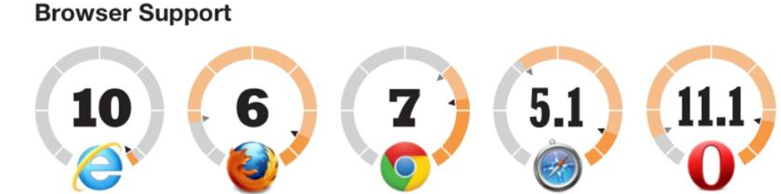
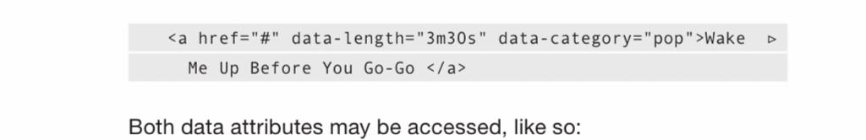

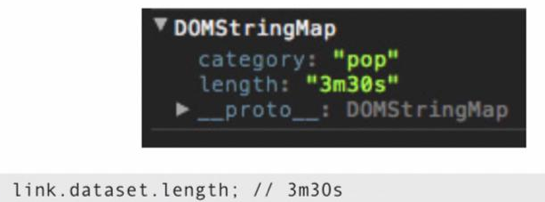
Custom Data Attribute
Definition and Usage
The data-* attributes is used to store custom data private to the page or application.
The data-* attributes gives us the ability to embed custom data attributes on all HTML elements.
The stored (custom) data can then be used in the page's JavaScript to create a more engaging user experience (without any Ajax calls or server-side database queries).
The data-* attributes consist of two parts:
The attribute name should not contain any uppercase letters, and must be at least one character long after the prefix "data-“
The attribute value can be any string
The dataset object, or DOMStringMap, returns a list of all data-attributes for the associated element.

Slide 29

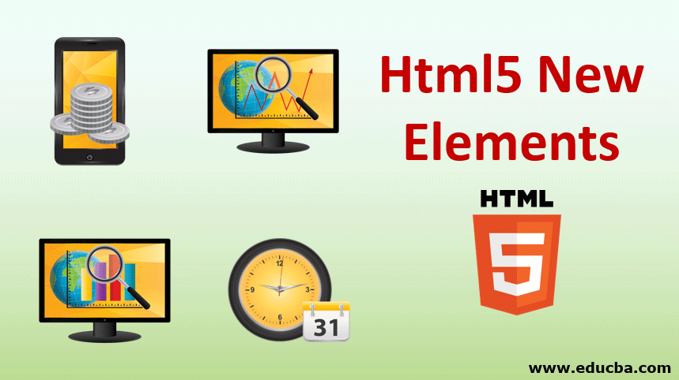
Html5 holds in it very interesting new elements that would make web more fun.

Slide 30
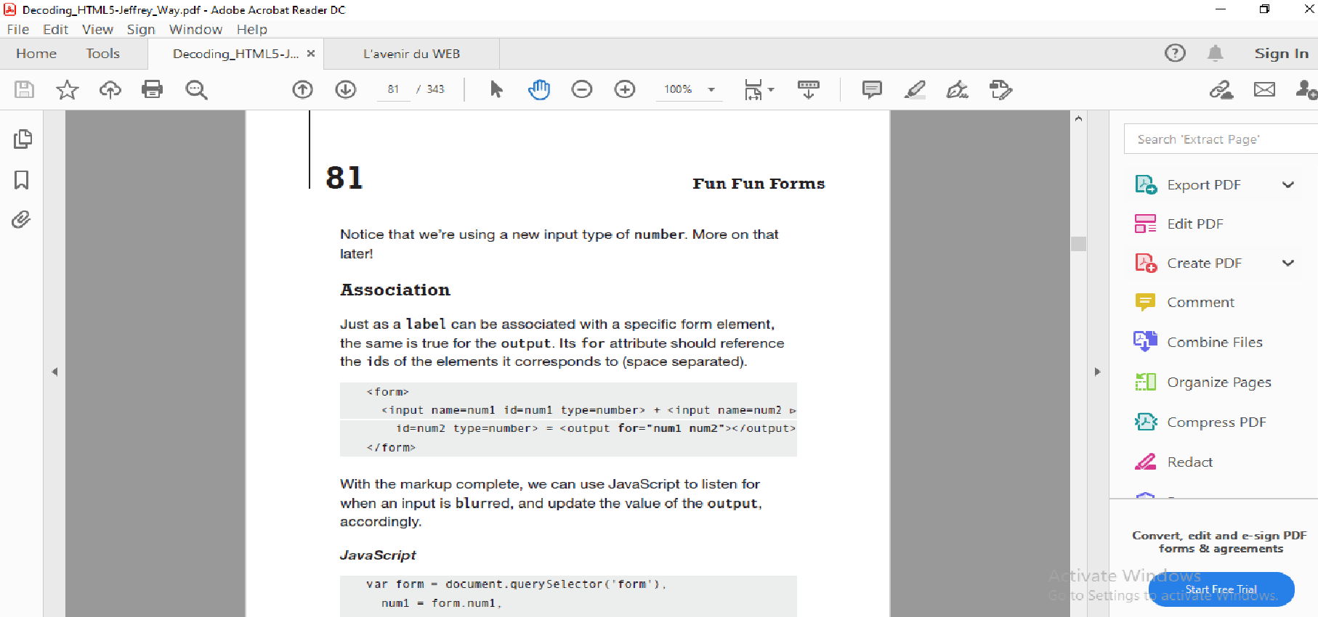
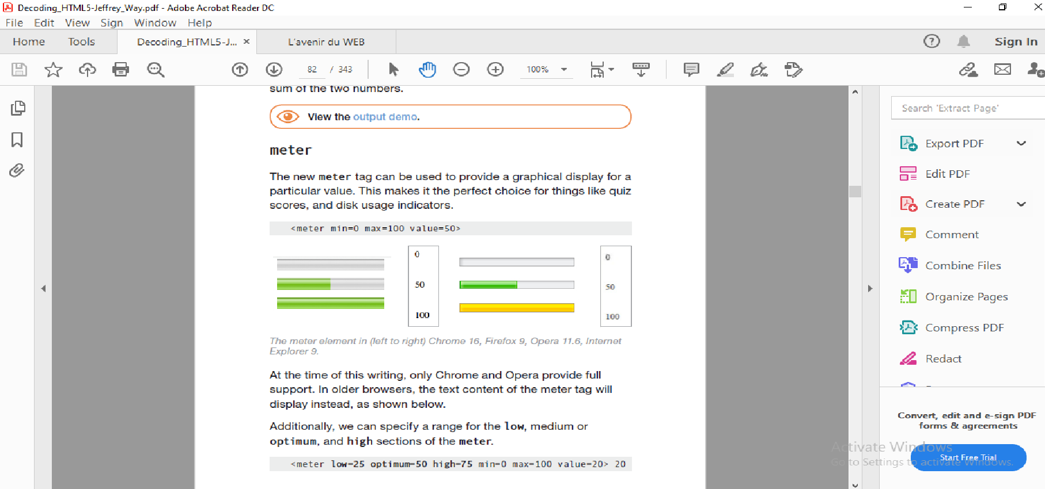
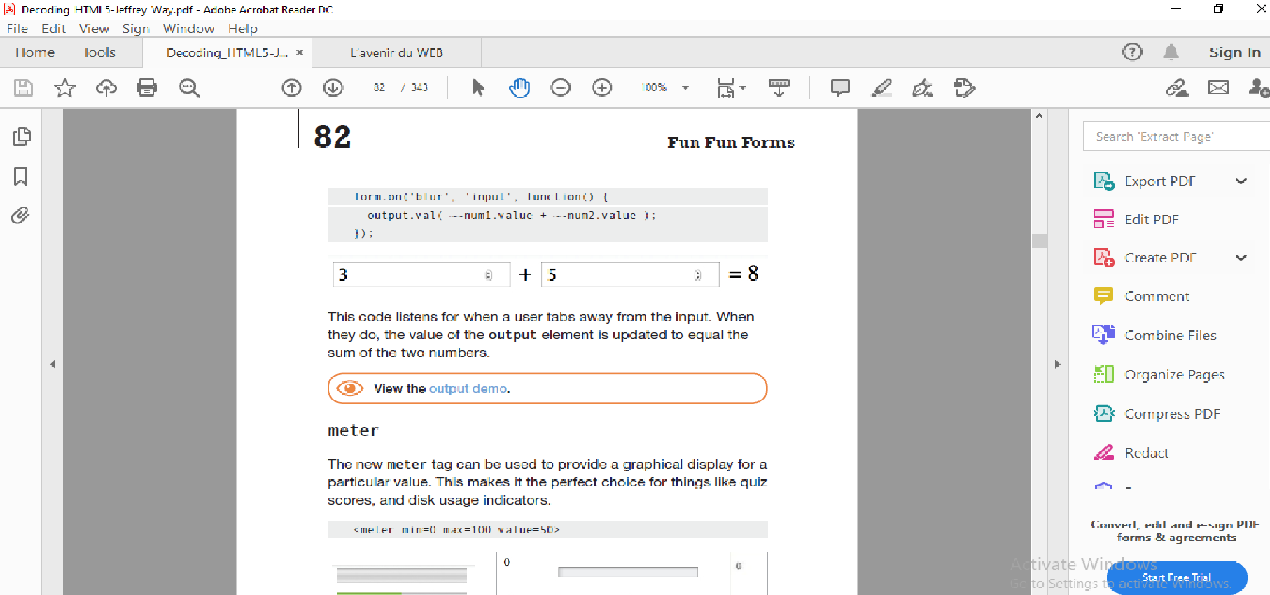
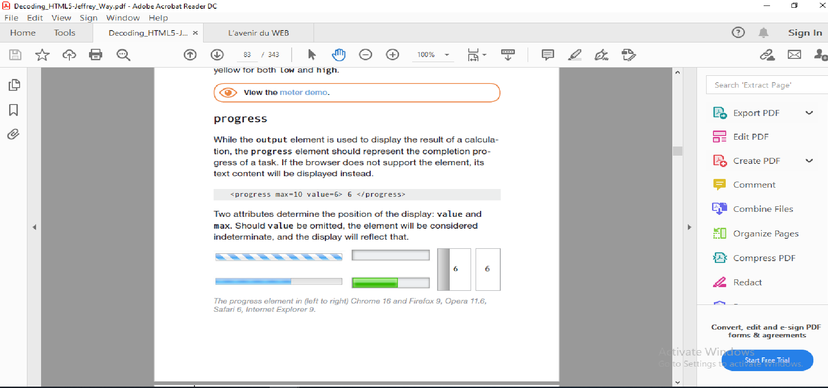
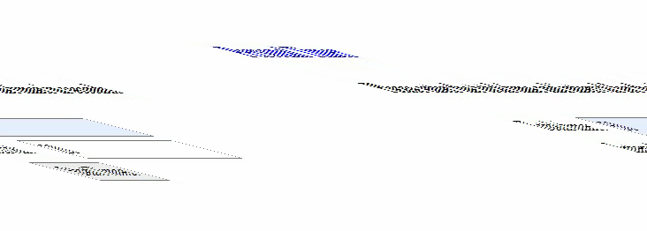
Output Tag
Meter Tag
The <output> tag is used to represent the result of a calculation.
The <meter> tag defines a scalar measurement within a known range, or a fractional value. This is also known as a gauge.
Progress Bar Tag
Demo. video
The <progress> tag represents the completion progress of a task.

Slide 31
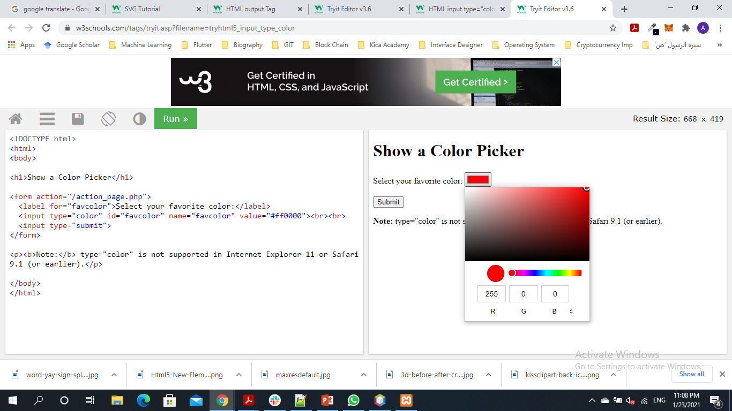
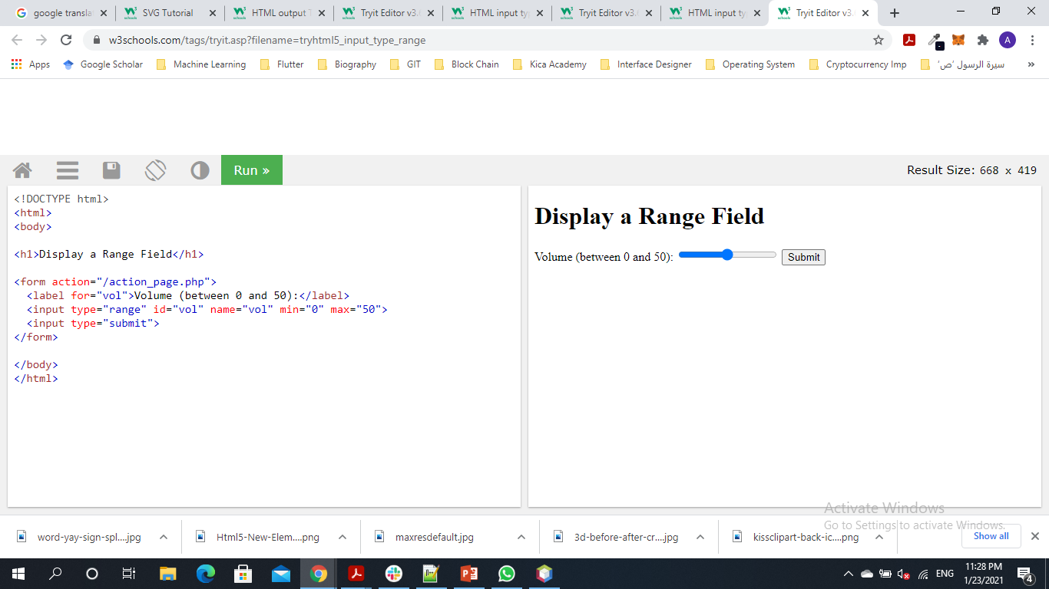
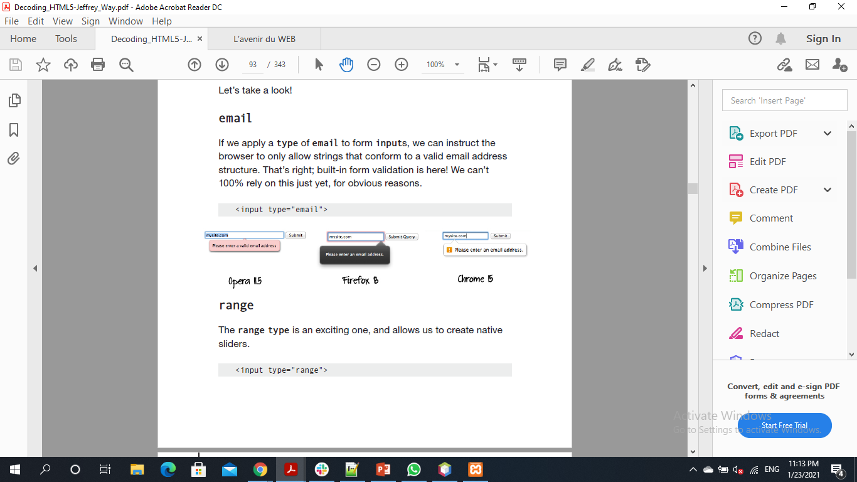
Input email The <input type="email"> defines a field for an e-mail address. The input value is automatically validated to ensure it is a properly formatted e-mail address.
Input color
The <input type="color"> defines a color picker.
Input range
The <input type="range"> defines a control for entering a number whose exact value is not important (like a slider control).

Slide 32
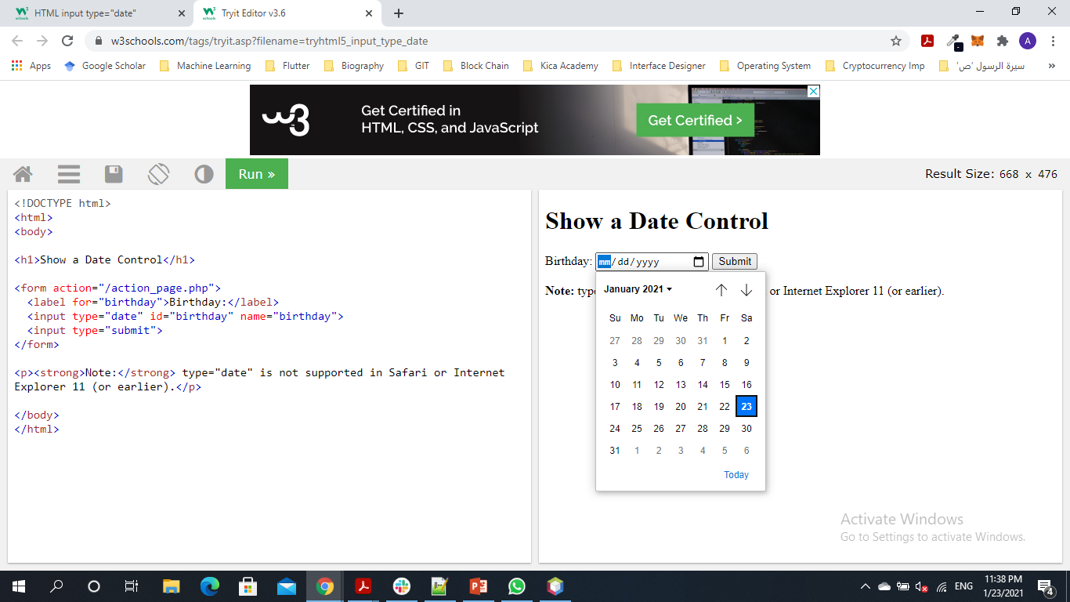
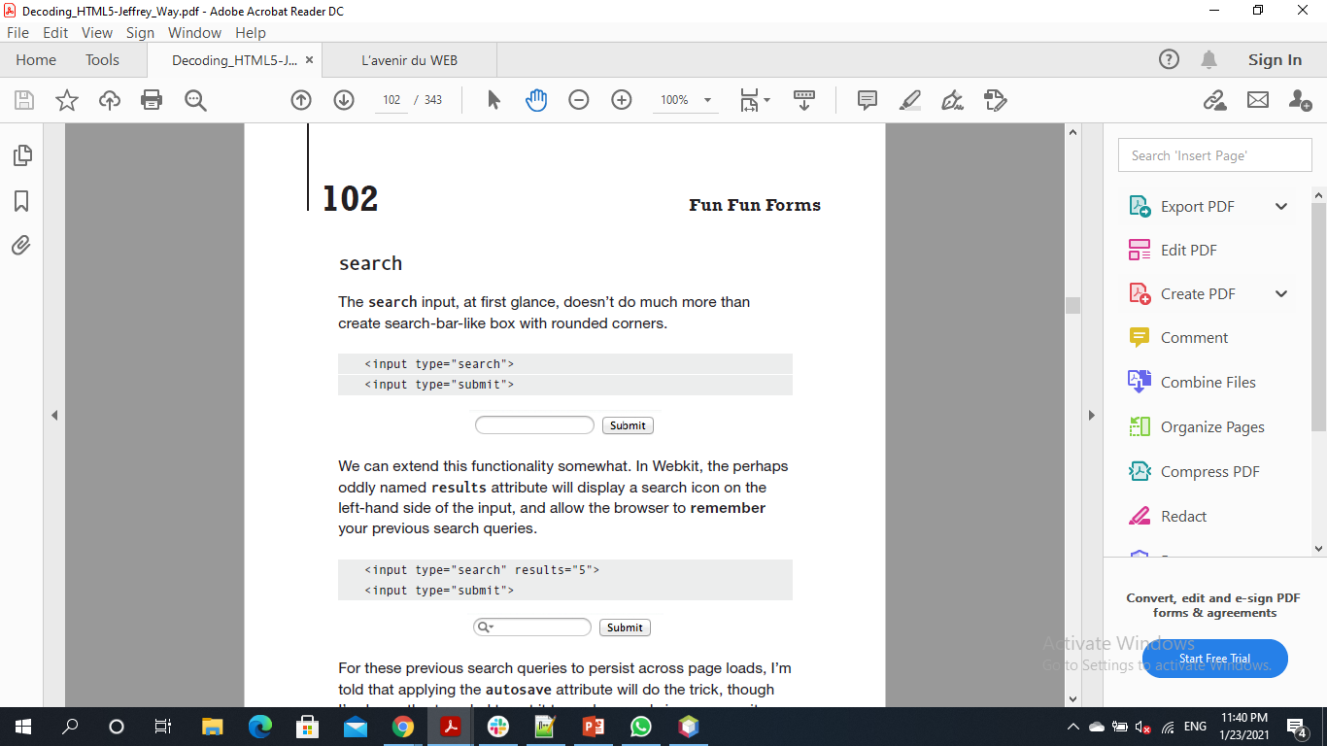
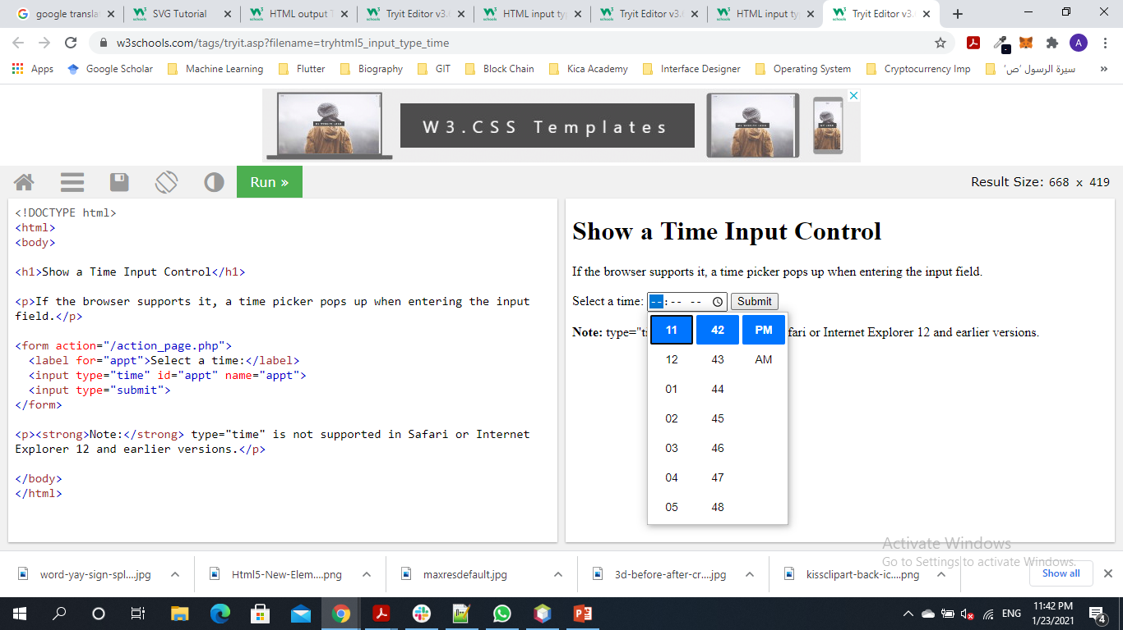
Input email
The <input type="date"> defines a date picker.
The resulting value includes the year, month, and day.
Input search
The <input type="search"> defines a text field for entering a search string
Input time
The <input type=“time”>defines a control for entering a time (no time zone).

Slide 33
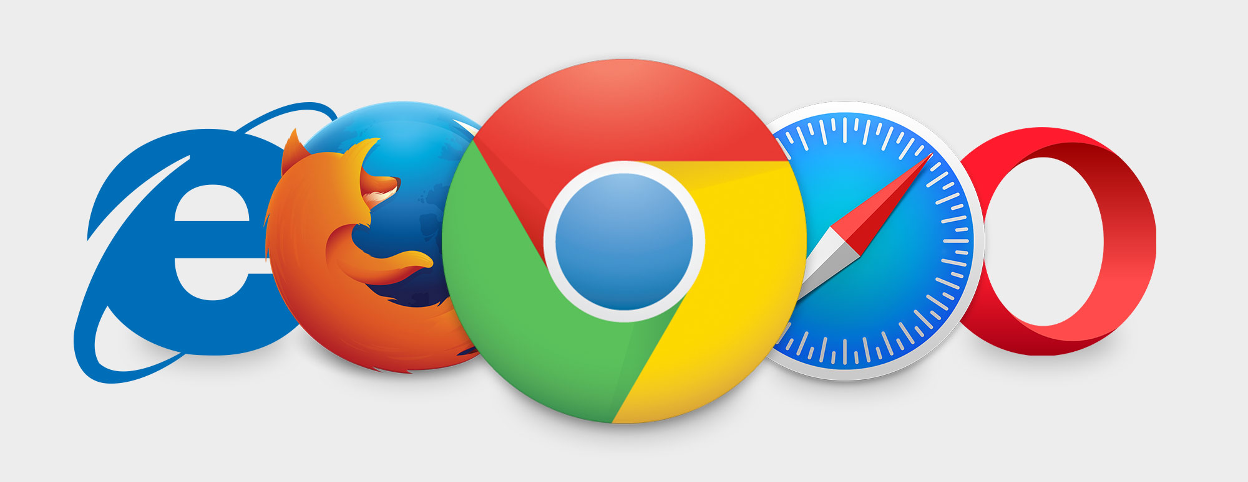

Slide 34
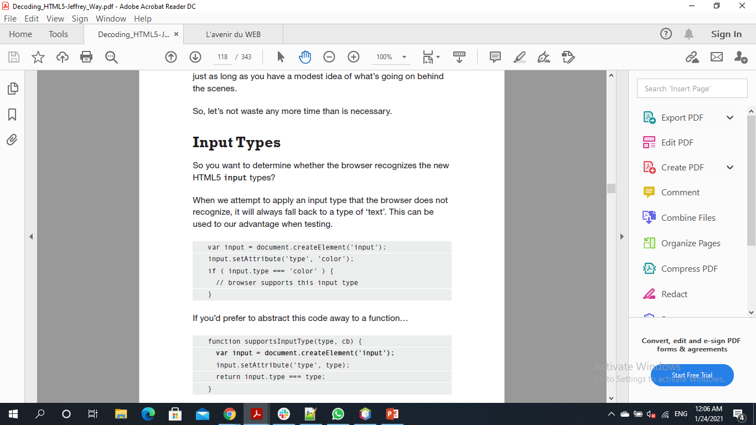
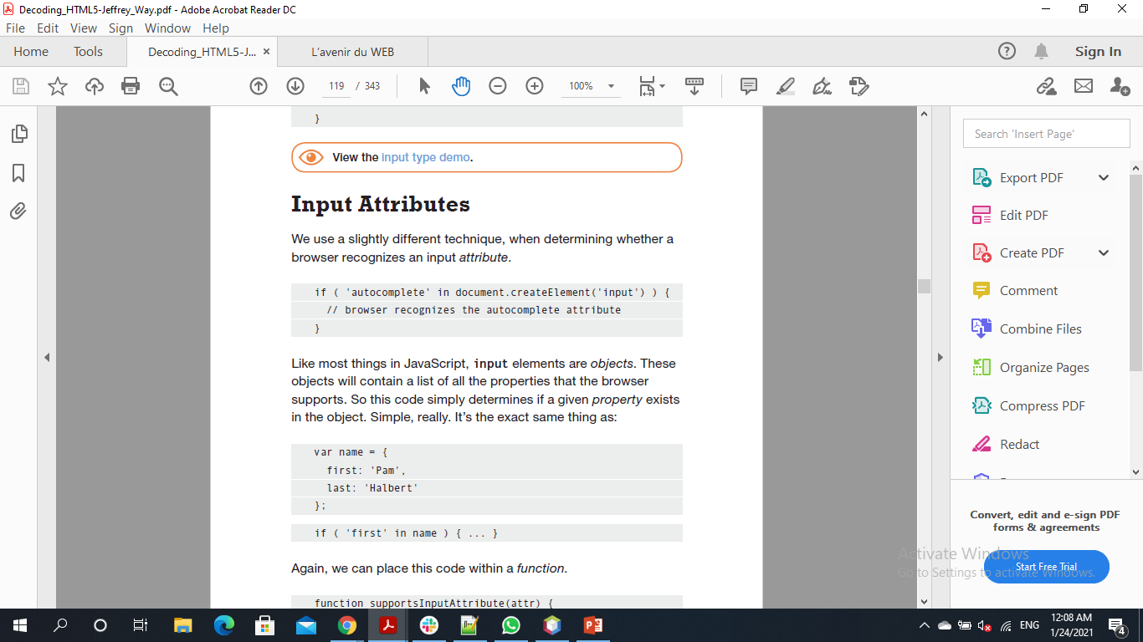
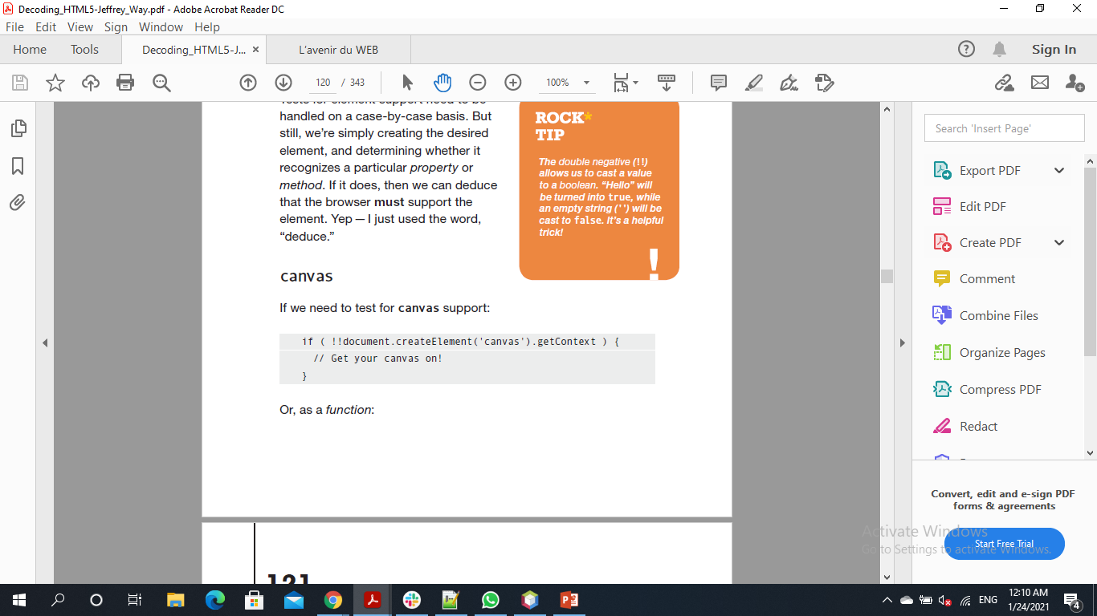
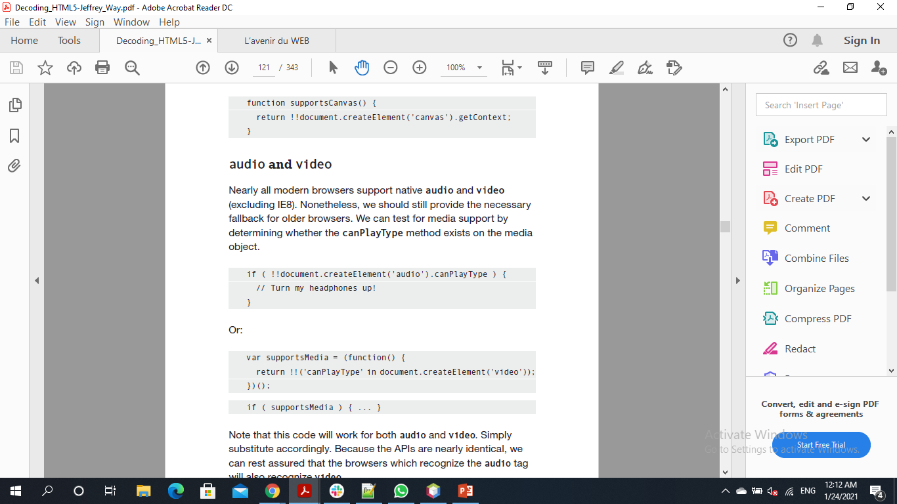
Check Browser Support
Input Types:
Input Attributes:
‘color’ type may be any of the new input types discussed.
‘autocomplete’ attribute may be any of the new input types discussed.
Elements:
Audio:
Canvas:

Slide 35
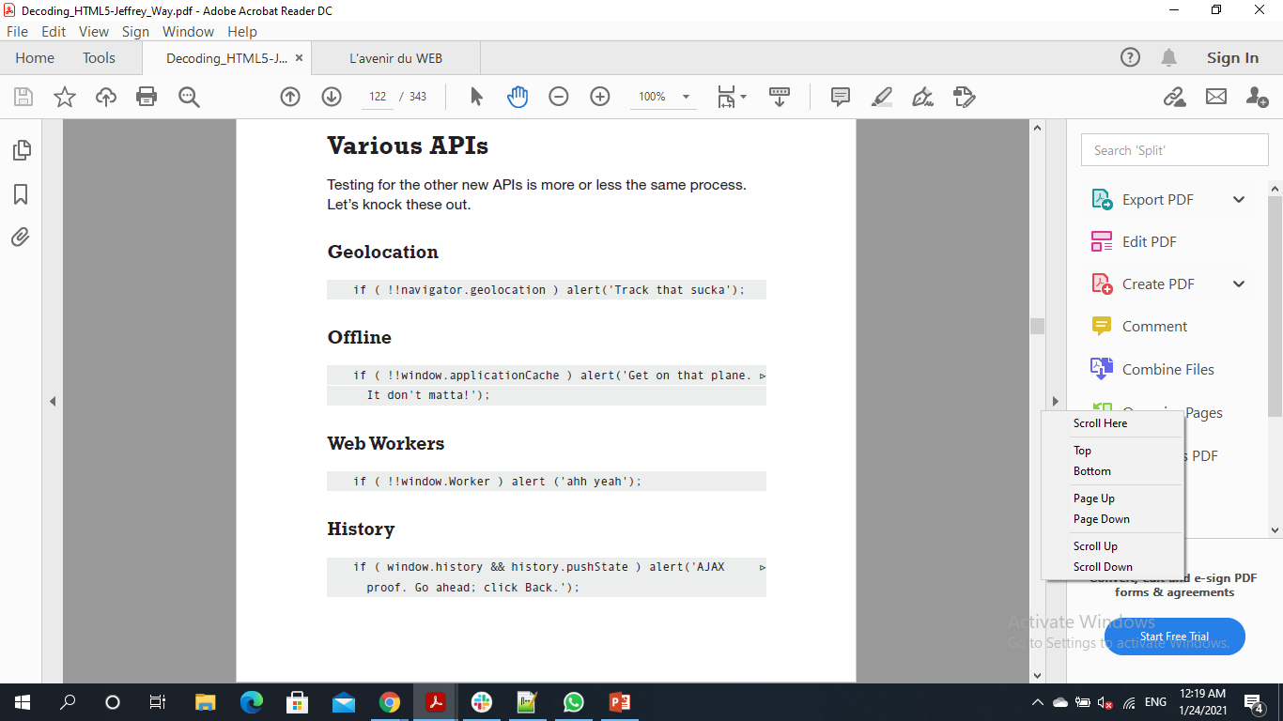

Check Browser Support

Slide 36


Slide 37


Modernizr is a JavaScript library that detects the features available in a user's browser. This lets web pages avoid unsupported features by informing the user their browser isn't supported
Syntax: Modernizr.input.ATTRIBUTE_NAME.
Modernizr.load:
Modernizr.load does not wait for the resource to finish loading before it moves on. This is how our pages can load faster.
It is asynchronous so that clients will not wait for the workers to load the scripts…
It is conditional so it works only when the specified condition is true

Slide 38


Slide 39


FINALLY VIDEOS

Slide 40


The controls attribute adds video controls, like play, pause, and volume.
It is a good idea to always include width and height attributes. If height and width are not set, the page might flicker while the video loads.
The <source> element allows you to specify alternative video files which the browser may choose from. The browser will use the first recognized format.
The text between the <video> and </video> tags will only be displayed in browsers that do not support the <video> element.
We can control our videos:

Slide 41

<Video attributes> Autoplay: This boolean attribute if specified, the video will automatically begin to play back as soon as it can do so without stopping to finish loading the data. Controls: If this attribute is present, it will allow the user to control video playback, including volume, seeking, and pause/resume playback. Loop: This boolean attribute if specified, will allow video automatically seek back to the start after reaching at the end. Preload: This attribute specifies that the video will be loaded at page load, and ready to run. Ignored if autoplay is present. Poster: This is a URL of an image to show until the user plays or seeks. Src: The URL of the video to embed. This is optional; you may instead use the <source> element within the video block to specify the video to embed

Slide 42


Slide 43


HTML5 Geolocation API
The HTML Geolocation API is used to locate a user's position.
The HTML Geolocation API is used to get the geographical position of a user.
Since this can compromise privacy, the position is not available unless the user approves it.
Geolocation API has methods to implement this definition. getCurrentPosition() and matchPosition(). Both returns attributes that describes the user’s position but with main difference that matchPosition() acts as live location where it updates its attributes whenever the user changes his location.
To display the result we need a map, so we use Google Maps.
As other APIs we can use polyfill to implement Html5 Geolocation on older browsers.

Slide 44



Slide 45


What is Canvas “ The canvas element provides scripts with a resolution-dependent bitmap canvas, which can be used for rendering graphs, game graphics, or other visual images on the fly. “ The HTML <canvas> element is used to draw graphics, on the fly, via JavaScript. The <canvas> element is only a container for graphics. You must use JavaScript to actually draw the graphics. Canvas has several methods for drawing paths, boxes, circles, text, and adding images. <canvas id="myCanvas" width="200" height="100"></canvas> Always specify an id attribute (to be referred to in a script), and a width and height attribute to define the size of the canvas. To add a border, use the style attribute.

Slide 46



A gradient is a smooth transition from one color to another. In addition, several color transitions can be applied to the same element. There are two main types of gradients : Linear Radial
^{[1]}
^{[2]}
Start by creating from where to where you want to have the gradient linear color ^{[1]}.
You can specify different colors to your shape by using the addColorStop() method(Create a “color change” point ) ^{[2]}.
Fill of canvas shape can also be a specific image pattern as desired.

Slide 47

Animation in canvas can be done using the method setInterval(fct, interval) that repeats the fct several time passed as interval parameter.
Moreover, it can be done by an illusion of animating objects by calling several functions that draws objects and change there positions.
This particles system is created using setInterval passing to it several fcts that generates the circle objects (particles) by creating specifying the position, width, height, color… of each particle.
Then calling the fct “draw” that will draw the stored particles
using canvas.arc() method.
3. Finally, the updatePosition() will modify the
Position of each particle slightly to create the illusion
Of animating.

Slide 48


Slide 49



Local Storage
With web storage, web applications can store data locally within the user's browser.
Before HTML5, application data had to be stored in cookies, included in every server request. Web storage is more secure, and large amounts of data can be stored locally, without affecting website performance.
Unlike cookies, the storage limit is far larger (at least 5MB) and information is never transferred to the server.
It stores data as key/value pairs
Even objects can be stored in localStorage by the help of JSON .stringify() to store objects as string and .parse() to get it back as object

Slide 50


Slide 51


The Web History API provides easy methods to access the windows.history object.
With its methods it allow saving the state of a page when navigating to another one and returning back.
• go()
• back()
• forward()
• pushState()
• replaceState()

Slide 52


Drag and Drop

Slide 53
Drag this box and drop it in its place

Slide 54


Slide 55

Drag and Drop
Drag and drop is a very common feature. It is when you "grab" an object and drag it to a different location.
We first need to specify the part that we will drop the draggable item in.
This is done by applying some methods: drag, drop, dragend, dragstart, dragenter, dragleave… in a JavaScript or jQuery function.
Then use FileReader() object to get the dragged element when dragging a file to the website.
And using dataTransfer.setData() and dataTransfer.getData() to drag and drop an item in the same page

Slide 56


Slide 57


Slide 58
Web Workers
A web worker is JavaScript helper code that runs in the background to create the illusion of running the code inparallel.
When executing scripts in an HTML page, the page becomes unresponsive until the script is finished.
A web worker is a JavaScript that runs in the background, independently of other scripts, without affecting the performance of the page.
To create a worker = new Worker(file.js);
Main HTML page (Employer) and its worker can communicate to get data from each other.
A worker uses postMessage() to send data to its employer (main page), the main page listens using onmessage() to the messages sent by the worker.
A necessary note that web workers does not have access to DOM in html page.

Slide 59
About The Author
Jeffrey Way is a developer evangelist and instructor who works for Envato. When not managing one of the most popular web development blogs in the world, Nettuts+, or creating courses for Tuts+ Premium, he enjoys playing with cutting edge web technologies, and finding new ways to teach complicated subjects and concepts, so that anyone can understand.
He is also the author of two other Rockable books: From Photoshop to HTML and Theme Tumblr Like a Pro, and can typically be found scanning Twitter when he should really be getting back to work.

Slide 60

Anissa Al Amin

